Slide 1
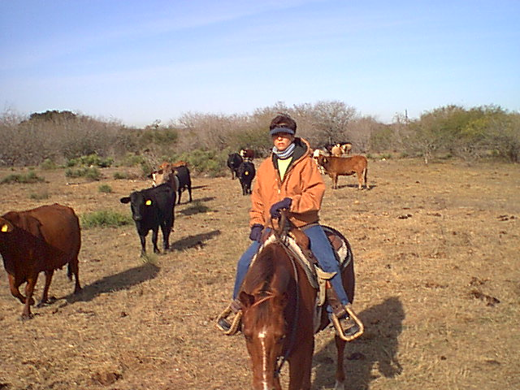
What every Texan should know about cattle.
Brett Bickham
Notes:
While here at Tarleton, I have noticed that a lot of students don’t know about the cattle business. This presentation should help.

Slide 2
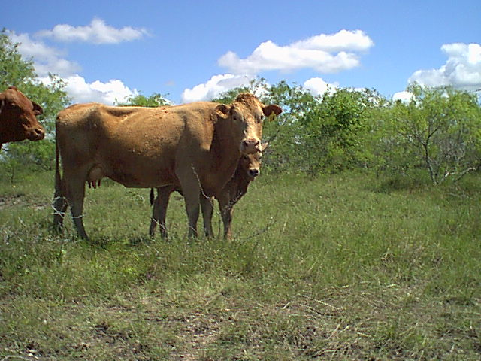
Overview
Uniformity
Seed Stock (Full Bloods)
Replacement Heifers (Half Bloods)
Beef Calves (Quarter Bloods)
Notes:
This presentation will cover uniformity and the different kinds of ranch operations.
This picture represents a seed stock herd.

Slide 3
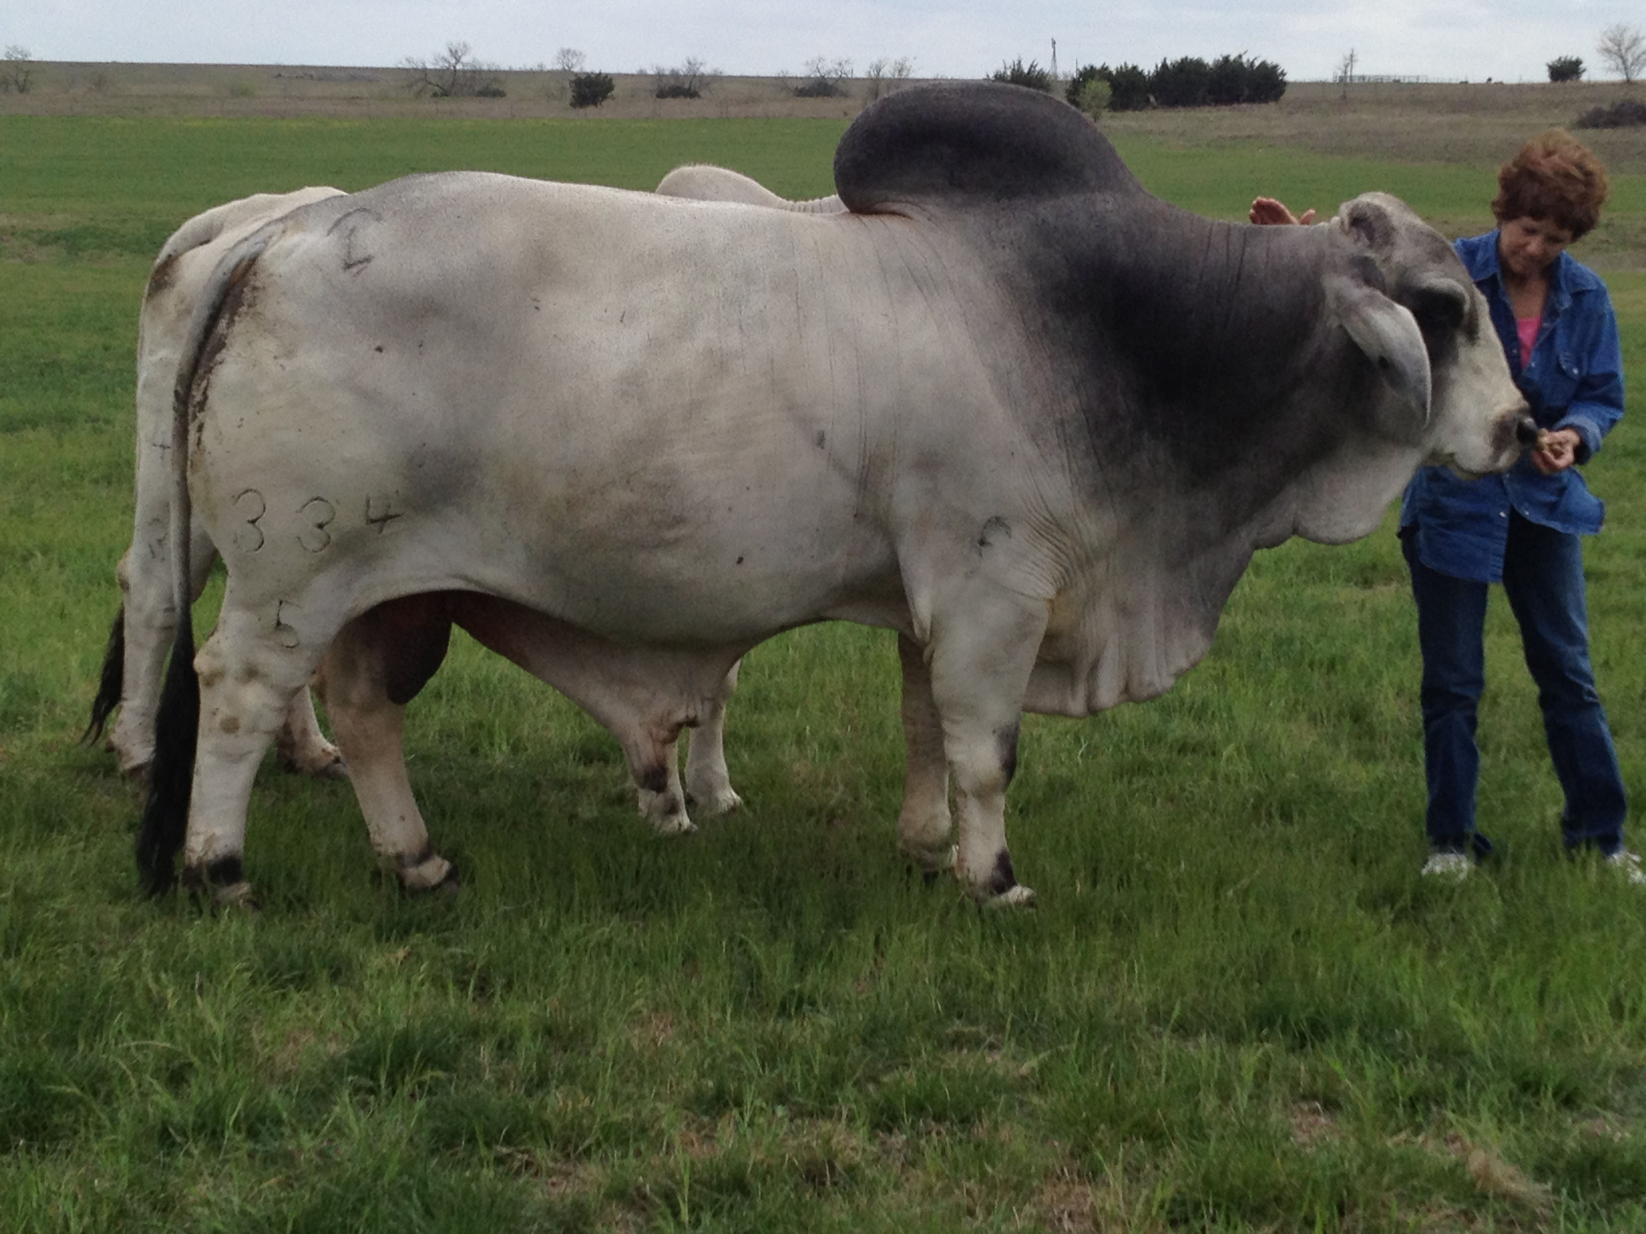
Overview
Calving Cycle
Grades
Hard Work
Notes:
This presentation will also describe
How many calves you get per year
How to grade cattle
The kind of work involved

Slide 4
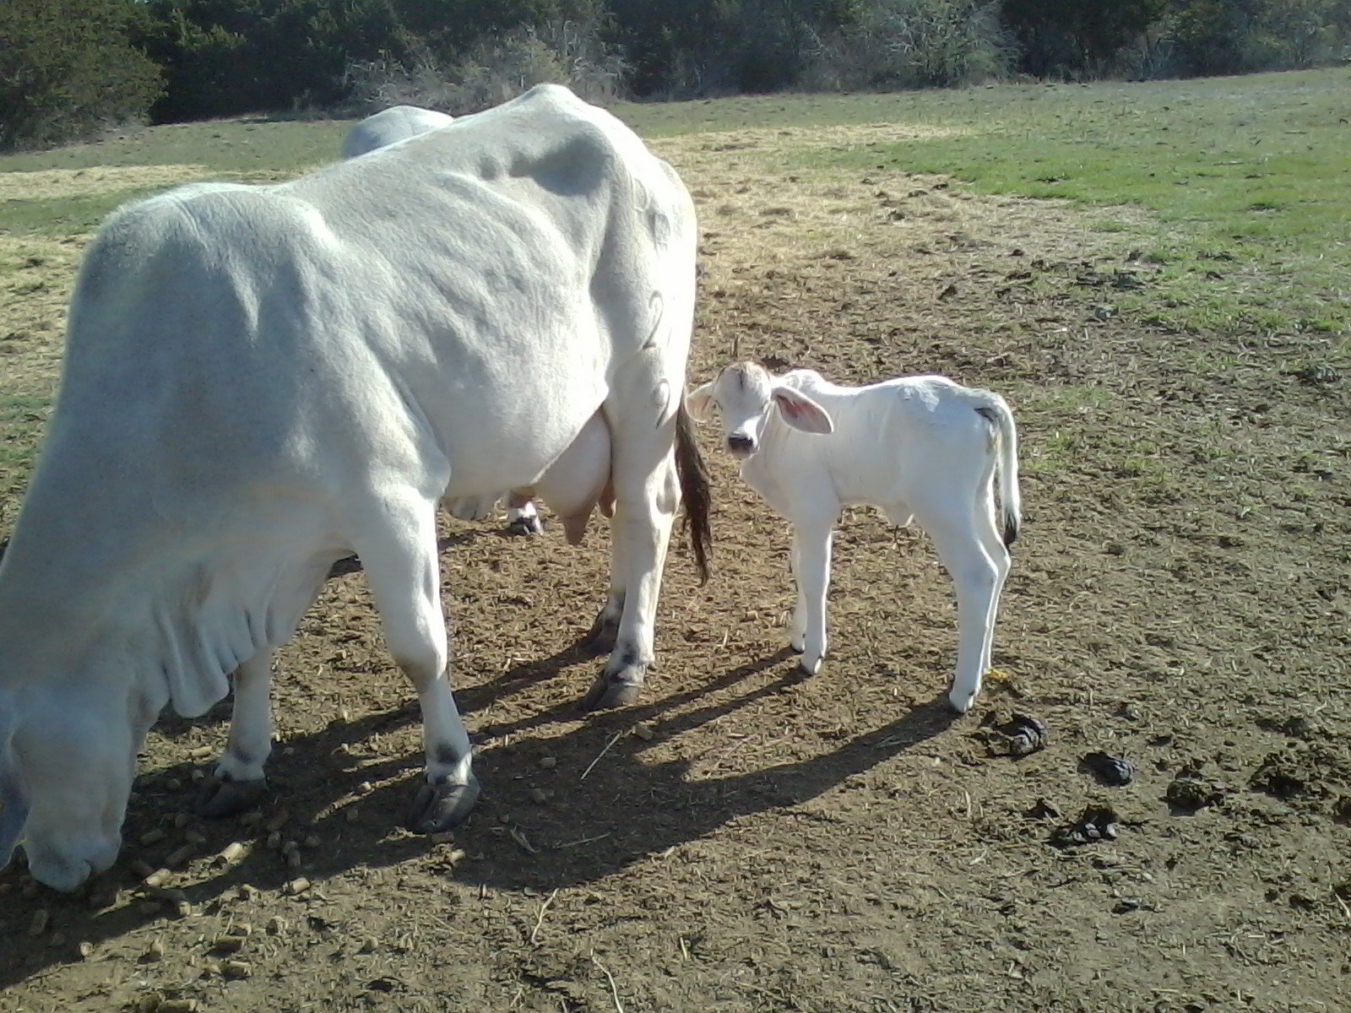
Uniformity
When ranchers breed full bloods and half bloods they have some control of the calf crops.
When ranchers breed mixed bloods they have to accept whatever they get.
Notes:
All ranchers should strive for uniformity in their cattle and calves. Uniformity shows the public and buyers that you are managing your herd.
Blood lines and the mixing of blood lines help determine uniformity.

Slide 5
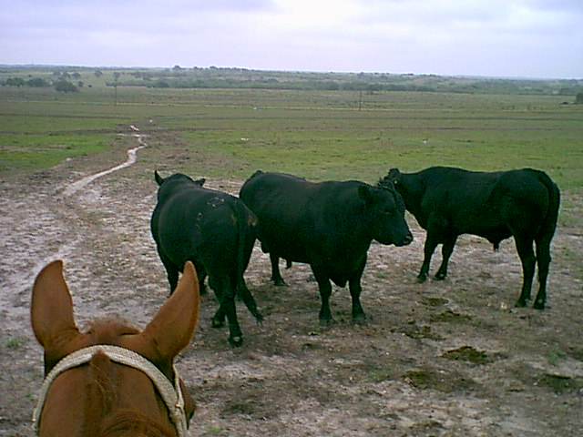
Ranchers should sell calves that are uniform
This can easily be done by:
Age
Color
Genetics
Notes:
This is a picture of 3 Angus bulls. The best way to have uniform calves is to have uniform bulls. By having a short breeding window, 2 months, and registered bulls, all of your calves will be the same age and color.
When you take a load of calves to the sale, they should all be close to 500 pounds and the same color.

Slide 6
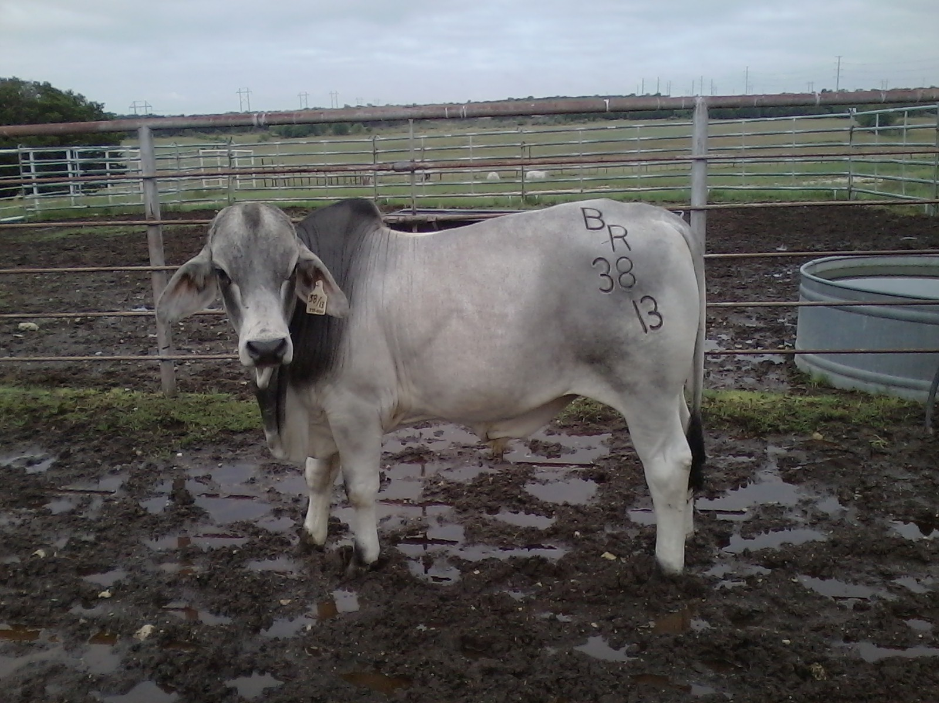
Seed Stock
Full blooded registered cattle
Both bulls and females are in demand
Notes:
This is a picture of a young Brahman bull. Seed stock refers to animals that are raised to promote and improve the industry. Different breeds provide different qualities desirable in the industry. Seed stock calves are raised to continue the blood lines.

Slide 7
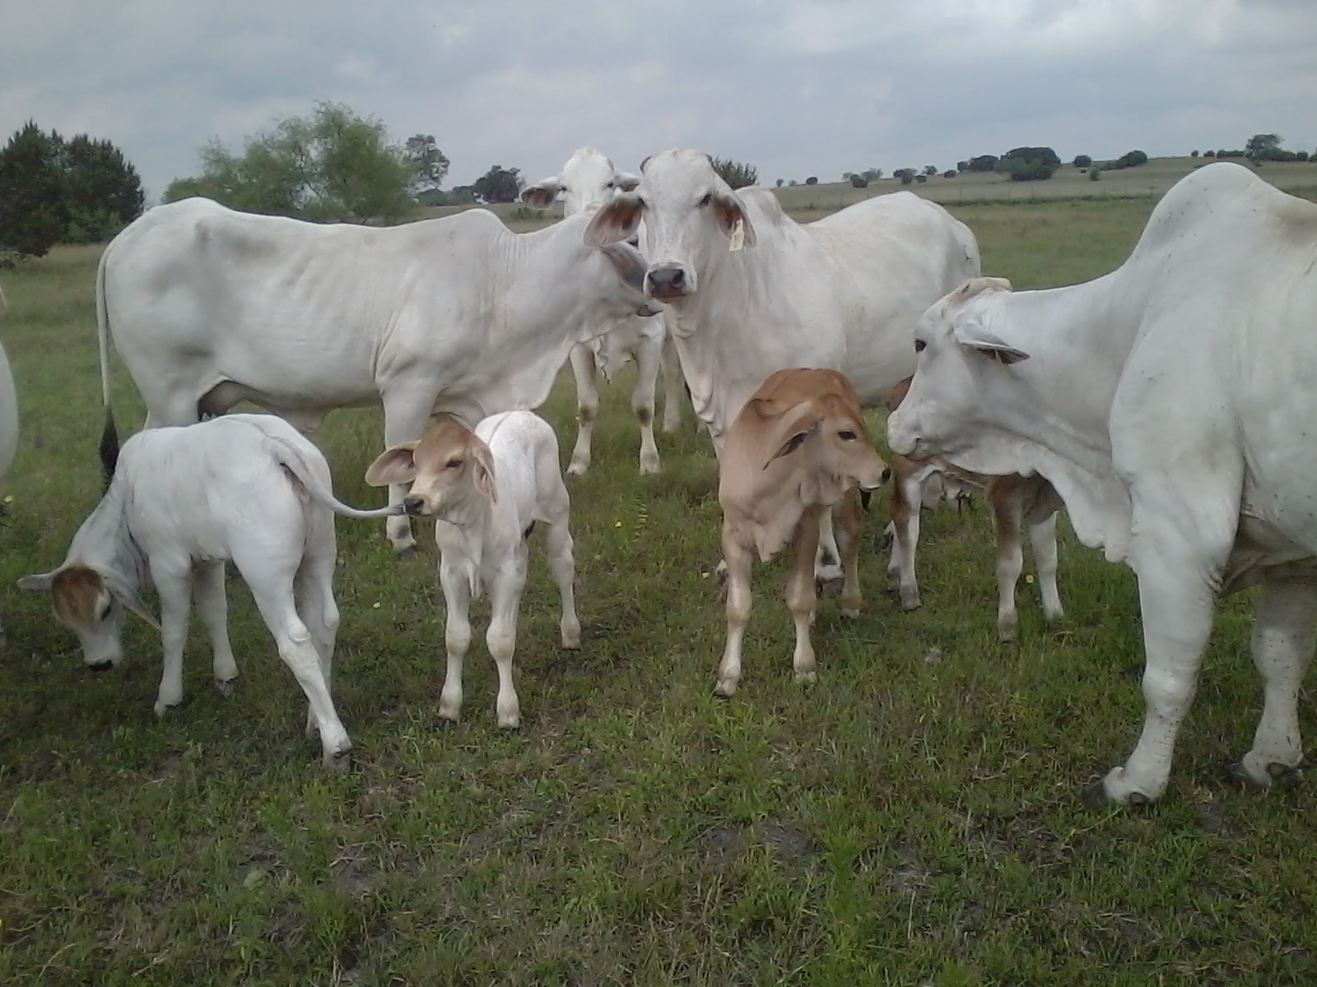
A Well-Managed Seed Stock Herd
Registered Bulls
Registered Females (same breed)
Registered Calves
Notes:
A well-managed seed stock herd consist of all registered animals of the same breed.

Slide 8
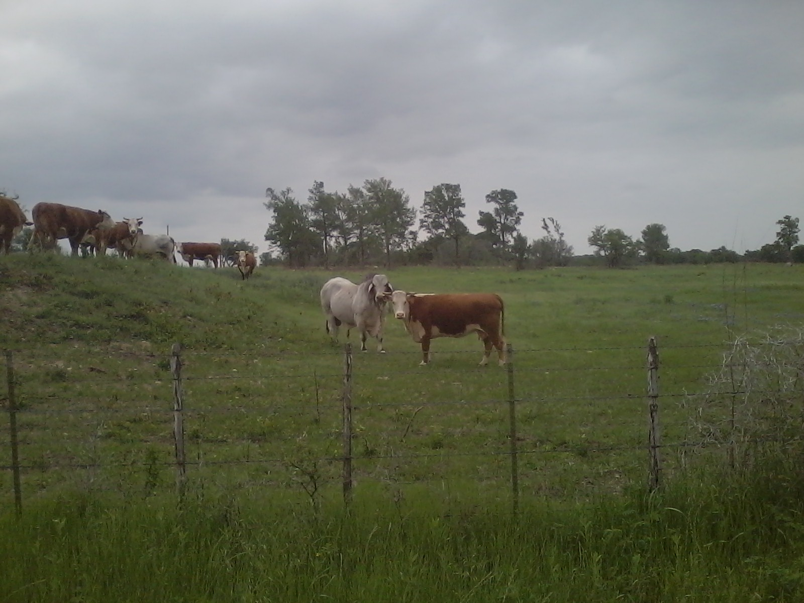
Replacement Heifers
F1 females (Half Bloods)
Females are in demand
Bulls are castrated and sent to a feed lot
Notes:
This is a picture of a Brahman bull and a Herford cow. Their calf will be either a 50/50 mix replacement heifer or a 50/50 bull calf. Replacement heifers refers to females raised for the sole purpose of being cows bred to have beef calves. When a rancher breeds for replacement heifers, half of the calf crop will be bulls. These bull calves are not the desired outcome. They are castrated and sent to the feed lot. They are discounted at the feed lots because of slower weight gain genetics.

Slide 9
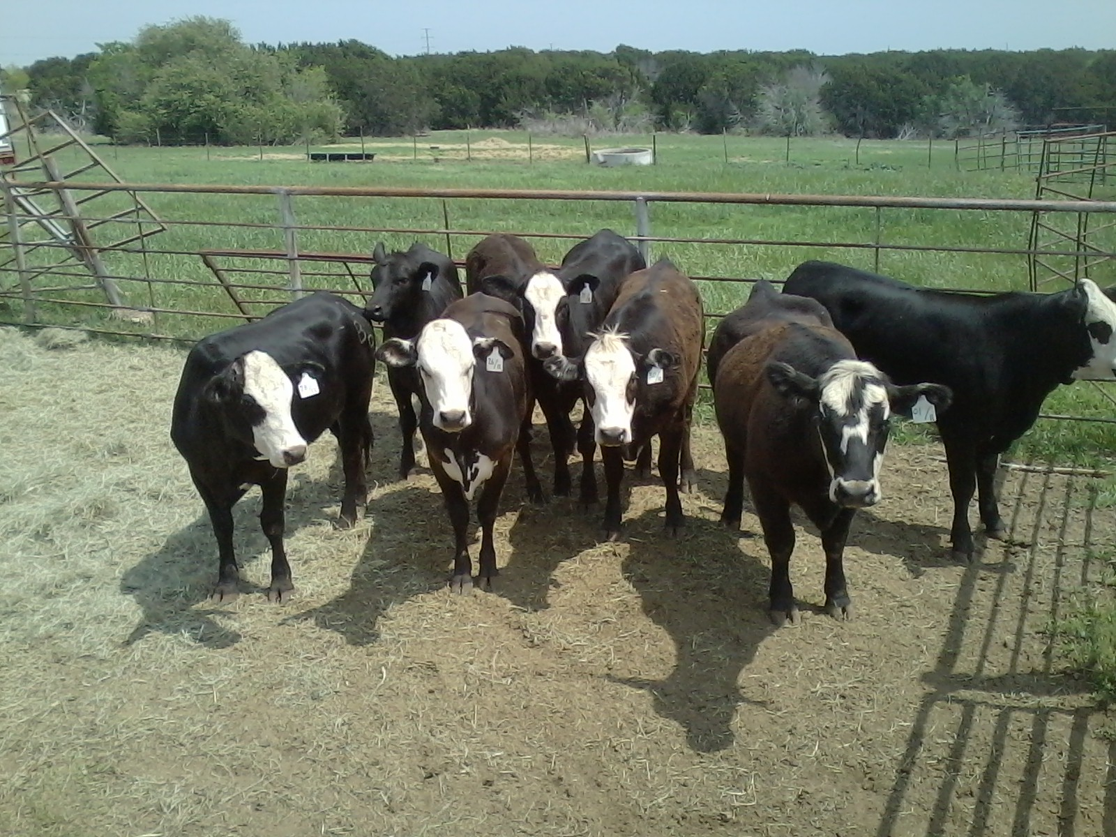
A Well-Managed Replacement Heifer Herd
Registered Bulls
Registered Females (different breed)
Certified F1 Calves
  Females raised as replacement heifers
  Males discounted and sent to feed lots
Notes:
A well-managed replacement heifer herd consist of all registered animals of different breeds. The bulls are of one breed and the cows are of another breed. Their calves are 50/50 mix blood lines. These are called F1 calves. These heifers are sold to ranchers who raise beef calves.

Slide 10
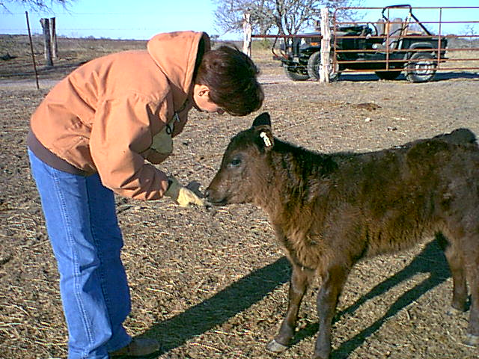
Beef Calves
Mixed bloods, preferable quarter bloods
Steers are in demand and go to feed lots
Females may be sent to feed lots as well
Notes:
Beef calves refer to animals raised for consumption. They have genetics for fast gain and quality grade meat. Unlike the replacement heifer breeders who wants heifers, the beef breeders wants bulls. The bulls are castrated around 3 months of age. The steers gain faster than the heifers. The faster a weaned animal can convert grain to pounds of beef, the more profitable.

Slide 11
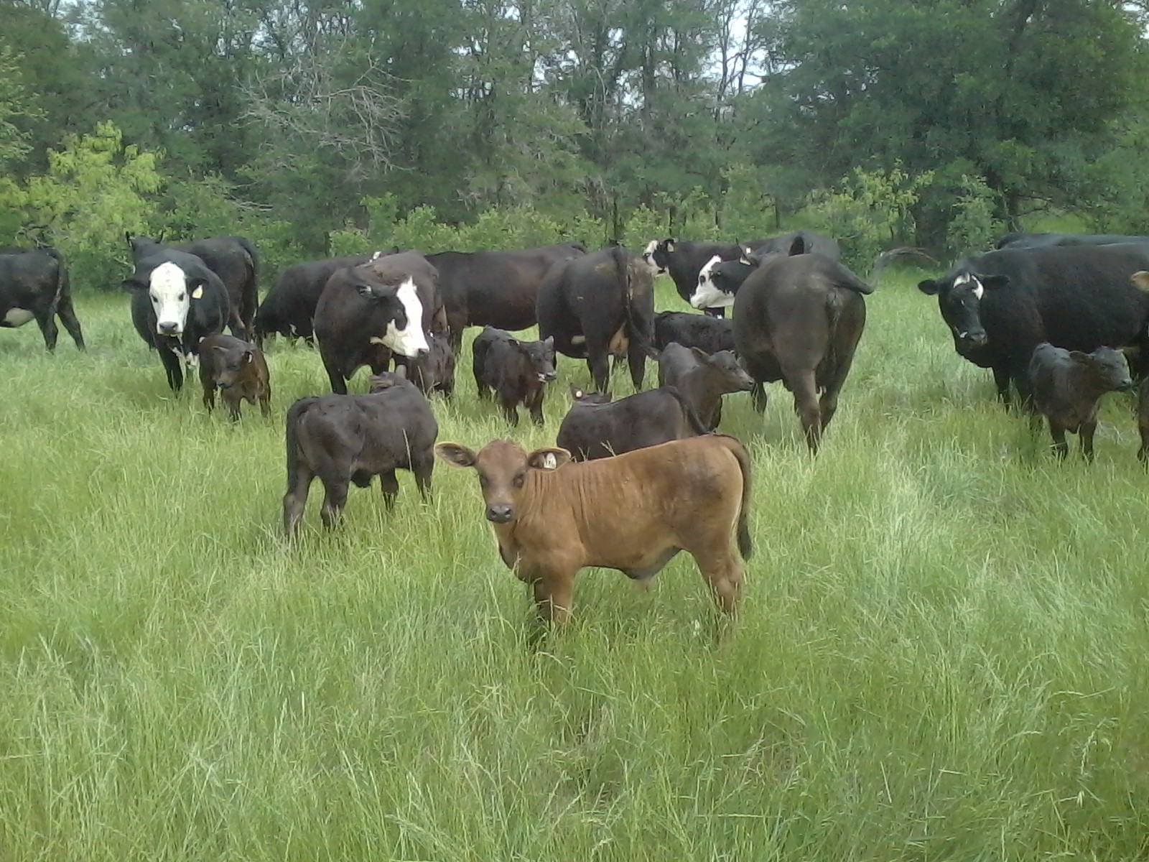
A Well-Managed Beef Cattle Herd
Registered Bulls (full blood)
F1 Females (half blood)
Quarter Blood Calves (raised for beef)
Notes:
This picture shows F1 cows, bred to a registered Angus bull, and quarter blood beef calves.

Slide 12
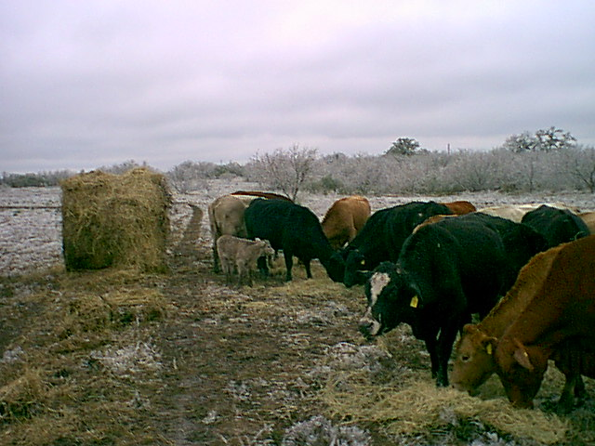
Calving Cycle
Cows have a 9-1/2 month pregnancy
Cows are bred back 2 months after calving
Cows typically have 1 calf per year
Notes:
This picture shows cows calving in January and February. By the time the calves are 2-3 months old lots of new spring grass will be everywhere. The cows can graze all summer while nursing their calves and by late fall the calves will be old enough to wean and sent to feed lots.

Slide 13
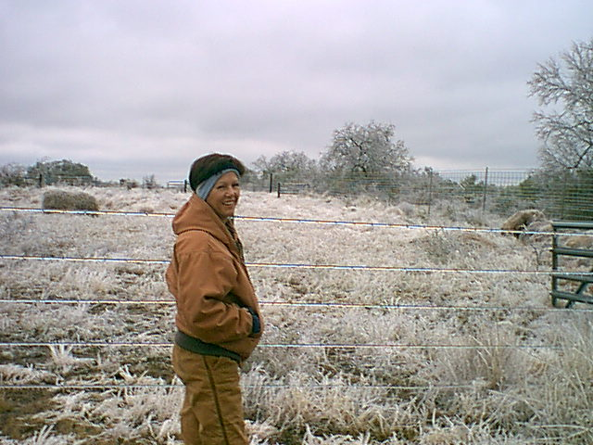
Phenotype/Genotype
Phenotype is the outward, observable structure
USDA Quality Grades:
1. Prime
2. Choice
3. Select
4. Standard
5. Commercial
6. Utility
USDA Yield Grades: Rated numerically 1, 2, 3, 4, and 5
Notes:
Phenotype is what you can see. Genotype is what you can’t see. Cattle are graded by what you can and can’t see. What you can see is their color, structure, and condition. What you can’t see is the quality of the meat. When the yearling is slaughtered, the USDA will then grade the meat and the animal’s yield.

Slide 14
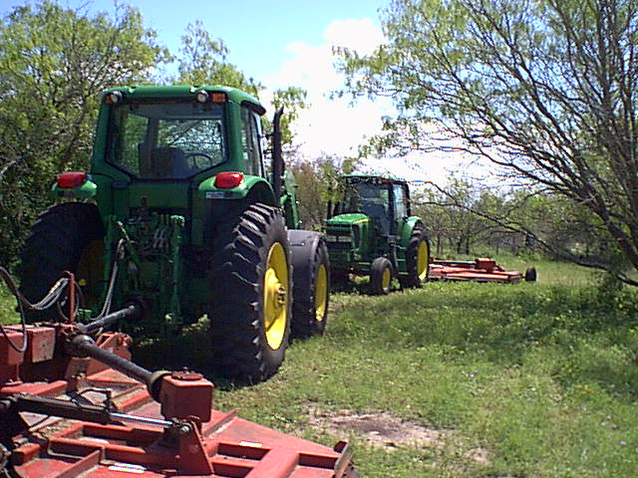
Lots of Hard Work
Mowing
Fence
Checking Water
Hay
Feeding
Vaccinating
Notes:
This picture shows mowing pasture. Cows like new tender growth. After a heavy rain, the grass will grow faster than the cows can keep up. Mowing not only helps control weeds, but stimulates new growth.
A cow can destroy a fence and water float by just looking at it.
Baling hay in the summer, and feeding hay in the winter, is very time consuming.
Sorting cattle, worming and vaccinating are done several times annually.

Slide 15
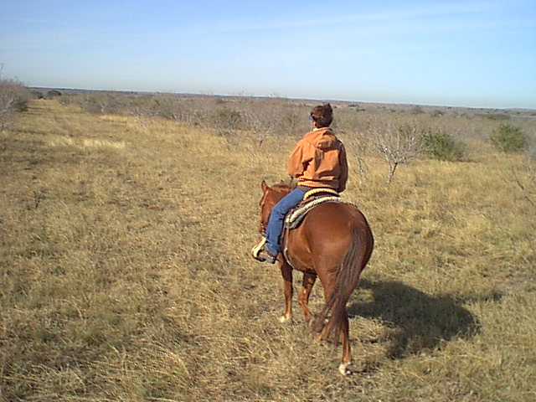
What every Texan should know about cattle.
Now you know,
Brett Bickham

